Slide 1

How to use Unity

Slide 2
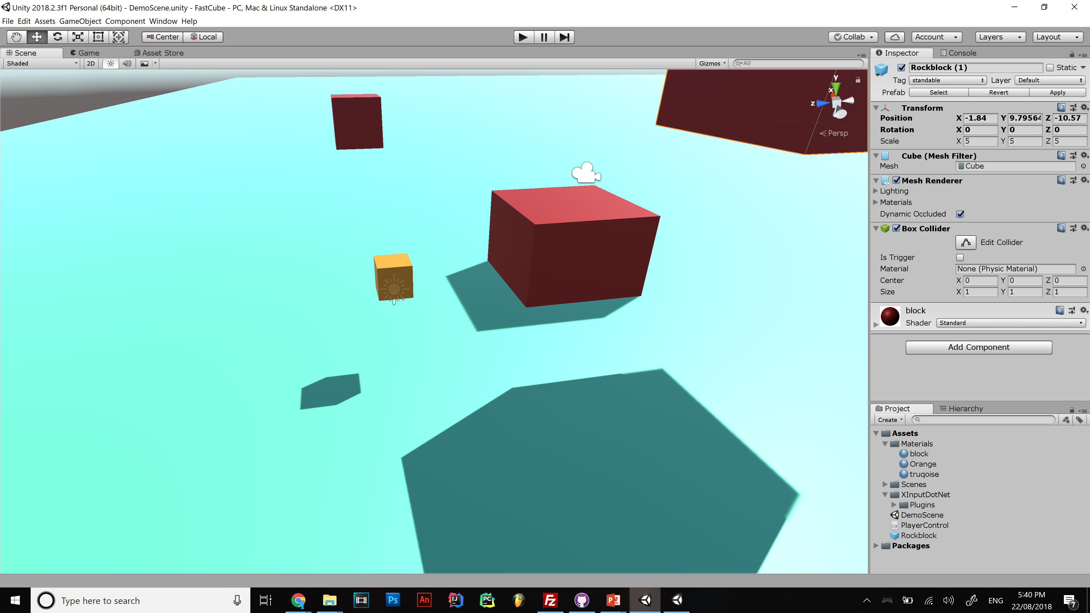

Game feel
Notes:
Assets folder is in the root of the project folder put all your stuff in there!!
Be organised and put scripts in Assets/Scripts , materials in Assets/Materials etc,,

Slide 3
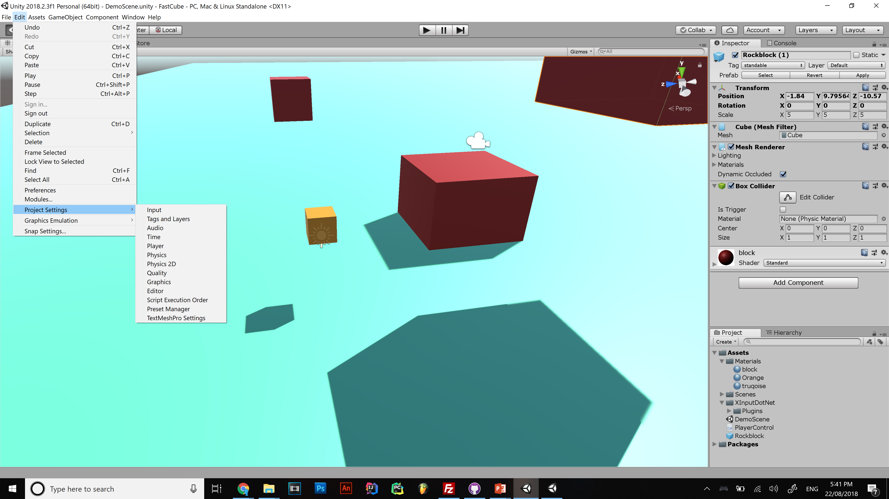

Slide 4
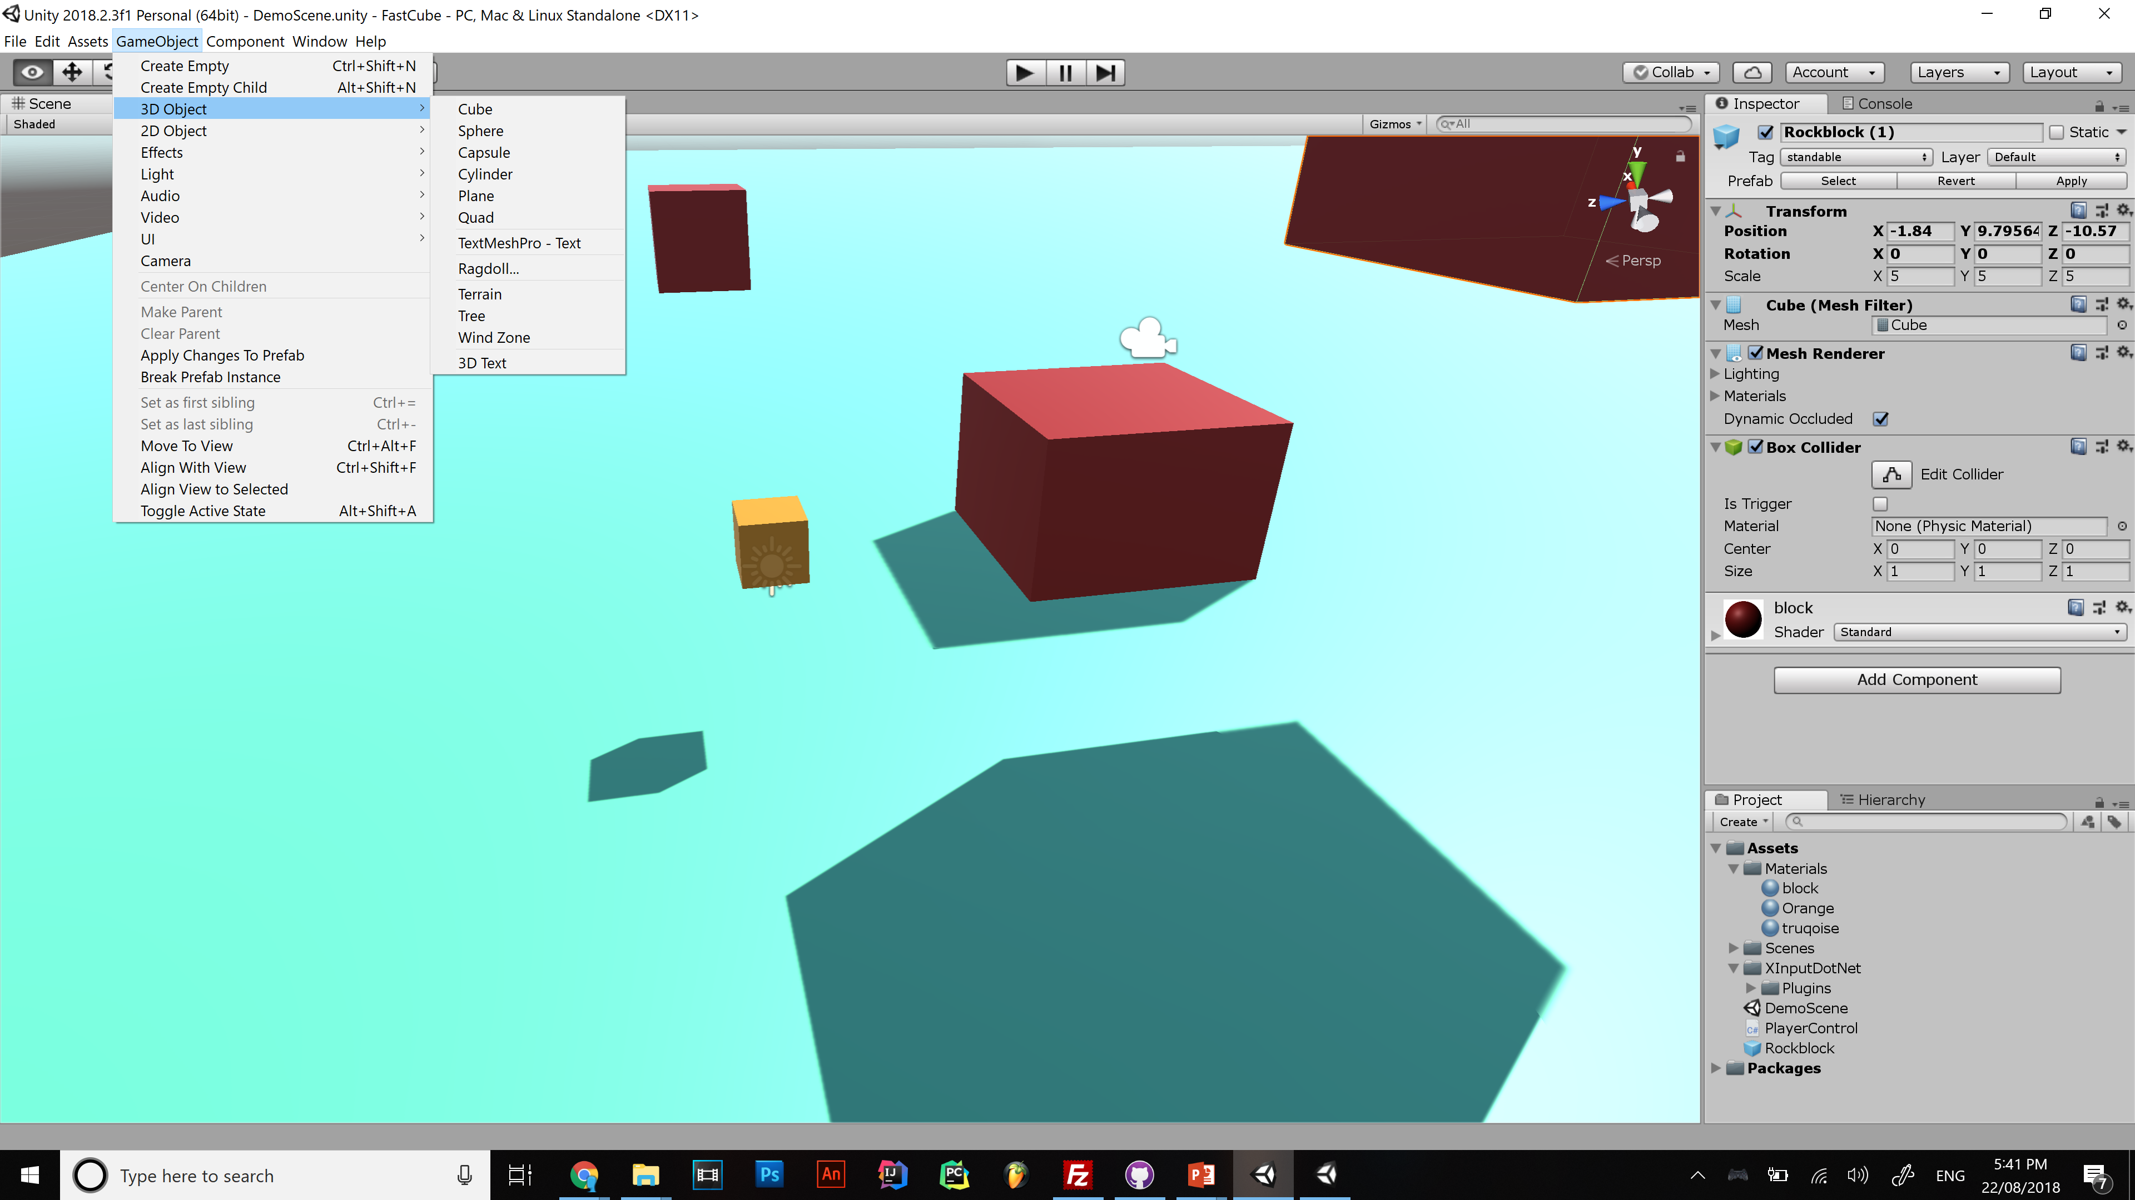

Slide 5
Unity organises games into scenes
Level 1
Main Menu
Level 2
Credits

Slide 6
Components

Slide 7
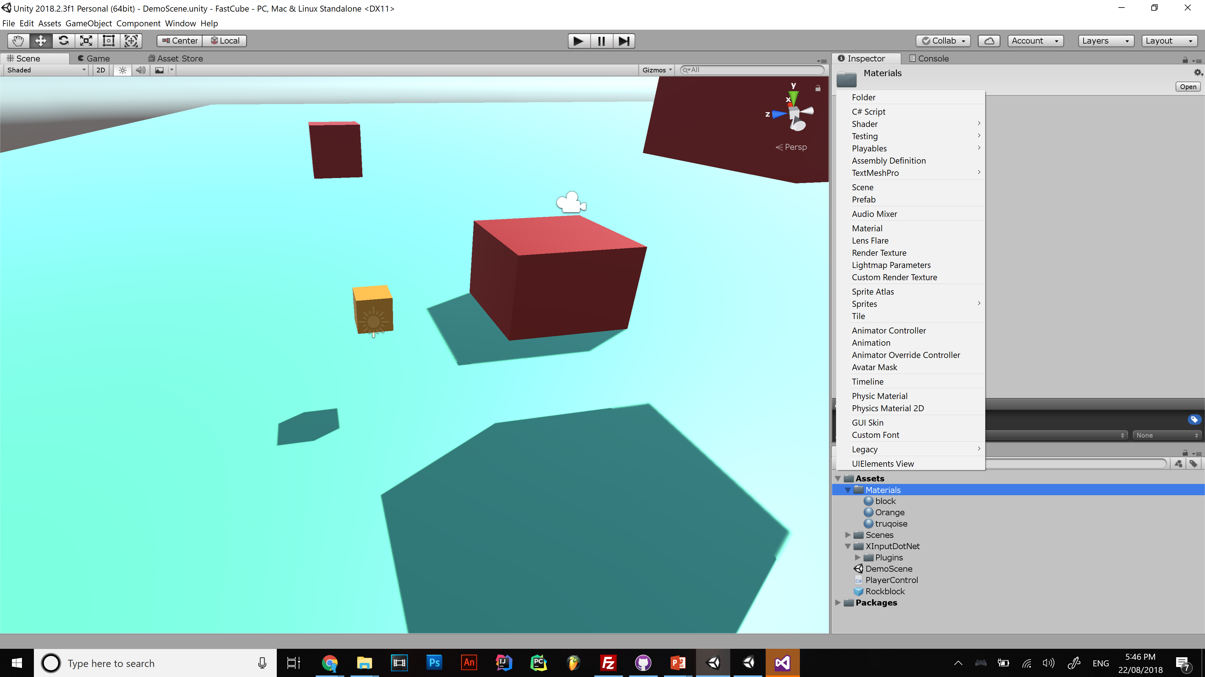

Slide 8
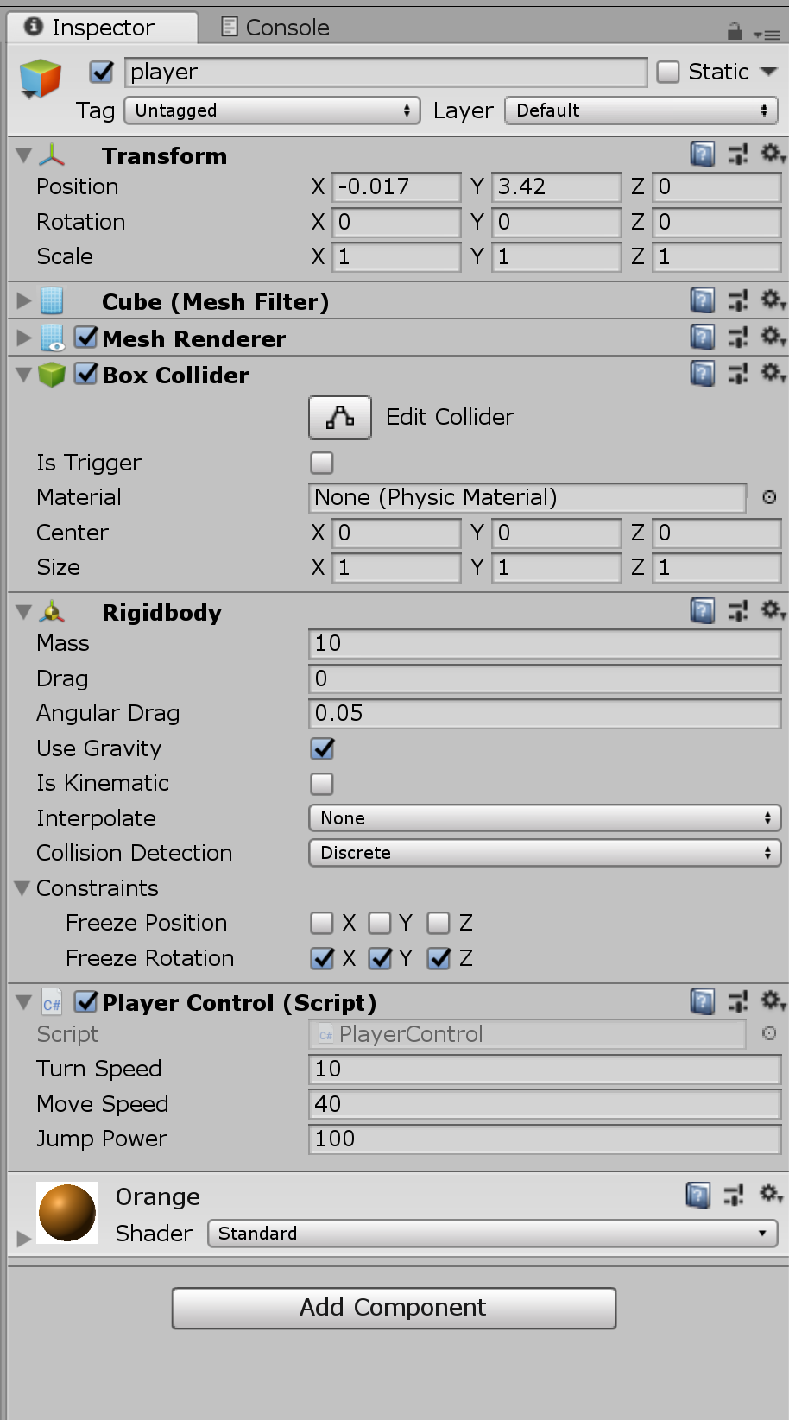
Unity is Game objects and engine settings
Game Objects
Transform
Mesh
Renderer
Components
Materials
Scripts
Physics
Collider
Animations
Audio
etc

Slide 9
If you understand all that you’re ready to code
Kinda..
Now install visual studio
DO YOU NEED PHYSICS? (probably)
Rigid body/Collider
Which you can get for free because you are a student

Slide 10
I like visual studio but you can also use any IDE you like

Slide 11
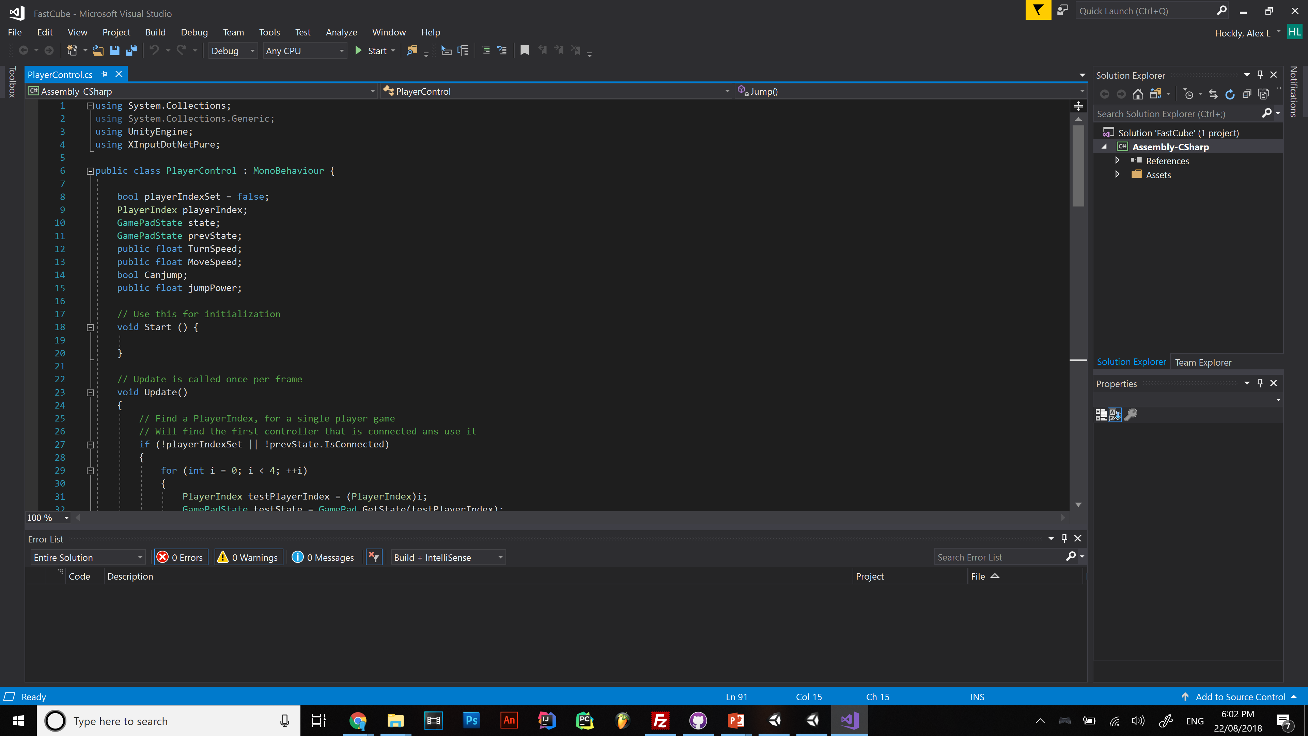
Notes:
UI breakdown

Slide 12
Look out for outdated info!! If a forum post is 3 years old avoid it

Slide 13
Unity documentation
https://docs.unity3d.com/ScriptReference/Transform.html

Slide 14
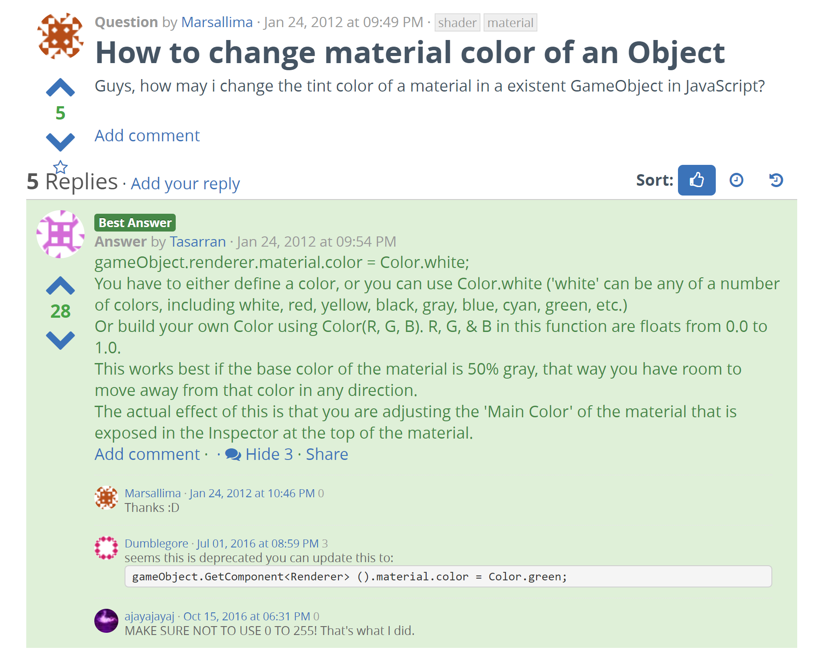
https://answers.unity.com/questions/209573/how-to-change-material-color-of-an-object.html

Slide 15
Making things happen
Void Start{
public float speed;
RigidBody rigbdy = gameObject.GetComponent<Rigid Body>();
}
Void Update{
rigbdy.AddForce(transform.forward * speed);
}

Slide 16
Realtime things
using UnityEngine;
using System.Collections; public class WaitForSecondsExample : MonoBehaviour {
void Start() {
StartCoroutine(Example());
} IEnumerator Example() {
print(Time.time);
yield return new WaitForSecondsRealtime(5);
print(Time.time);
}
}

Slide 17
Some more unity concepts
Prefabs
Primitive geometry
Tags
.unityPackage

Slide 18
Next time
Vector3()
Corutines

